Slide 1



🧹 Data Wrangling
❓ Missing Values
🔄 Data Transformation
Notes:
1

Slide 2




SECTION 1 — DATA WRANGLING
What Is Data Wrangling?
Data Wrangling means cleaning and preparing raw, messy data so it's ready for analysis or machine learning. Think of it like washing vegetables before cooking — you can't skip it!
Raw Data
Missing values, wrong formats, errors
Clean Data
Complete, consistent, correct
Useful Data
Ready for analysis or ML
Notes:
2

Slide 3


SECTION 1 — DATA WRANGLING
Why Do We Need Data Wrangling?
Real-world data is almost never perfect. Before we can trust our analysis, we must fix common problems that sneak into every dataset.
Common Problems in Raw Data
Example: Raw Student Table
Missing Values
Name
Age
Marks
Some cells are blank or NaN
Arun
20
85
Incorrect Data
Ravi
21
Missing
Ages like 999, negative marks
Kumar
Missing
72
Duplicate Rows
Before analysis, we must clean this data — otherwise our results will be unreliable.
Same student recorded twice
Wrong Formats
Numbers stored as text
Notes:
3

Slide 4
SECTION 1 — DATA WRANGLING
The Data Wrangling Process
Data Wrangling follows a clear, repeatable workflow. Master these five steps and you'll be able to handle almost any messy dataset you encounter.
Raw Data
Load your messy, unprocessed dataset into Pandas.
Inspect Data
Use df.head(), df.info(), and df.describe() to understand the shape of your data.
Find Problems
Spot missing values, incorrect entries, and inconsistencies.
Clean & Transform
Remove or fill missing values, fix types, create new columns.
Ready for Analysis
Your clean data is now ready for visualization or machine learning.
Key Idea: Wrangling = making messy data useful.
Notes:
4

Slide 5
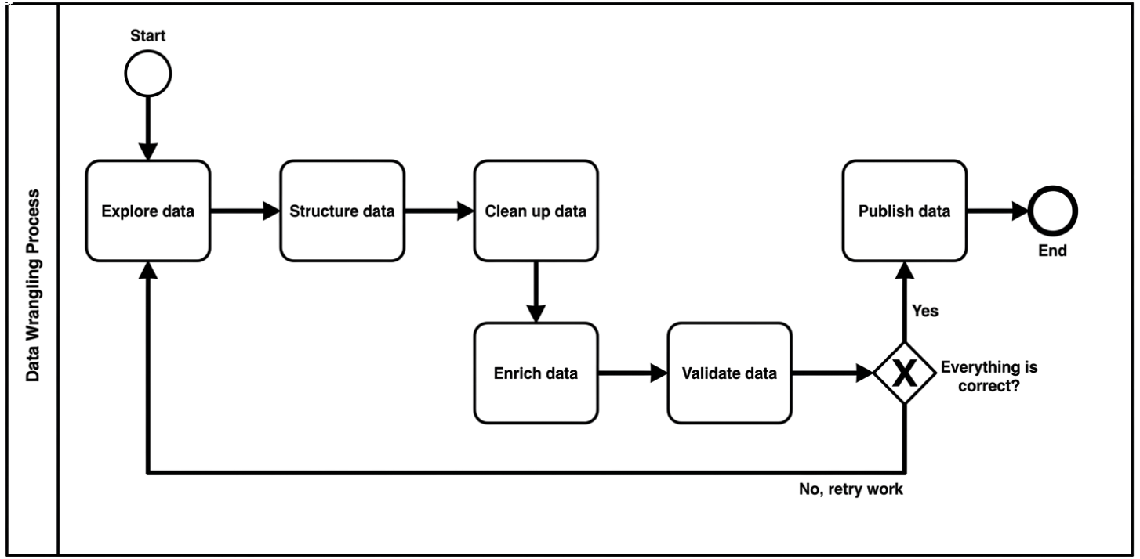
The Data Wrangling Pipeline
Notes:
4

Slide 6
SECTION 2 — MISSING VALUES
What Is a Missing Value?
  A Missing Value means that a particular piece of data was not recorded, not collected, or simply unavailable.
  In Pandas, missing values appear as NaN — which stands for Not a Number.
Example Dataset
What Does NaN Mean?
Name
Age
Marks
NaN
Why It Matters
Arun
20
85
Not a Number — Pandas' way of saying "this value is missing."
Operations on NaN produce unreliable results. Always handle missing data first!
Ravi
21
NaN
Kumar
NaN
72
Notes:
5

Slide 7
SECTION 2 — MISSING VALUES
Creating Our Student Dataset
Let's create the CSV file and load it into Pandas. This dataset will be used throughout the entire session. Notice that some cells are intentionally left blank — these become NaN in Pandas.
students.csv
Load with Pandas
Name,Age,Marks,City
Arun,20,85,Chennai
Ravi,21,,Chennai
Kumar,,72,Vellore
Priya,20,90,Chennai
Anu,22,,
import pandas as pd
df = pd.read_csv("students.csv")
print(df)
Run this in Jupyter Notebook or Google Colab. The blank cells in the CSV become NaN automatically when loaded.
Notes:
6

Slide 8
SECTION 2 — MISSING VALUES
Our Dataset Output
After loading the CSV, this is what Pandas shows us. Notice the NaN values — these are the missing data points we need to deal with before any analysis.
DataFrame Output
What's Missing?
Name
Age
Marks
City
Age
Marks
Arun
20.0
85.0
Chennai
Kumar's age is missing
Ravi and Anu have no marks
Ravi
21.0
NaN
Chennai
Kumar
NaN
72.0
Vellore
City
Priya
20.0
90.0
Chennai
Anu's city is not recorded
Anu
22.0
NaN
NaN
Notes:
7

Slide 9
SECTION 2 — MISSING VALUES
Finding Missing Values: isnull()
The df.isnull() function scans every cell in your DataFrame and returns True where data is missing and False where data is present. It's your first diagnostic tool.
Code
How to Read the Output
print(df.isnull())
True
False
Value is missing — needs attention.
Value is available — no action needed.
Output
Name
Age
Marks
City
Use isnull() to get a bird's-eye view of where your data has gaps.
False
False
False
False
False
False
True
False
False
True
False
False
False
False
False
False
False
False
True
True
Notes:
8

Slide 10


SECTION 2 — MISSING VALUES
Counting Missing Values: isnull().sum()
Why This Matters
While isnull() shows a full table of True/False values, isnull().sum() gives you a quick count of missing values per column — much easier to read at a glance.
This single command tells you exactly where to focus your cleaning efforts. Marks has the most missing values (2), so it needs the most attention.
Code
1
print(df.isnull().sum())
Age
Output
2
Column
Missing Count
Name
0
Marks
Age
1
Marks
2
1
City
1
City
Notes:
9

Slide 11

SECTION 2 — MISSING VALUES
Two Ways to Handle Missing Values
Once you've found missing values, you have two fundamental strategies. Your choice depends on how much data is missing and how important that row is to your analysis.
Option 1: Remove
Option 2: Fill
dropna()
fillna()
Delete any row that has at least one missing value. Best when you have plenty of data and missing rows are few.
Replace missing values with a meaningful substitute — like "Unknown" for text or the column mean for numbers. Best when you want to keep all rows.
  Simple and fast
  May lose important data
  Use when missing % is small
  Keeps all your data
  Requires a good fill strategy
  Use when data is hard to collect
Rule of thumb: If less than 5% of data is missing, dropping is fine. Otherwise, prefer filling.
Notes:
10

Slide 12

SECTION 2 — MISSING VALUES
Removing Missing Rows: dropna()
dropna() removes every row where any column has a missing value. It's the quickest fix — but use it carefully, because you permanently lose those rows.
Code
What Happened?
df_clean = df.dropna()
print(df_clean)
Arun ✅ Kept
All values are complete.
Result
Ravi ❌ Removed
Missing Marks.
Name
Age
Marks
City
Arun
20
85
Chennai
Kumar ❌ Removed
Priya
20
90
Chennai
Missing Age.
Priya ✅ Kept
All values are complete.
Anu ❌ Removed
Missing Marks and City.
Notes:
11

Slide 13
SECTION 2 — MISSING VALUES
Filling Missing Text: fillna()
Instead of deleting rows, we can fill missing values with a sensible default. For text columns like City, we replace NaN with a placeholder like "Unknown".
Code
After
df["City"] = df["City"].fillna("Unknown")
print(df[["Name", "City"]])
Name
City
Arun
Chennai
Before
Anu
Unknown
Name
City
How It Works
Arun
Chennai
The fillna("Unknown") function scans the City column and replaces every NaN it finds with the text "Unknown". The original rows are preserved — nothing is deleted.
Anu
NaN
Notes:
12

Slide 14
SECTION 2 — MISSING VALUES
Filling Missing Numbers with the Mean
For numeric columns like Marks, filling with the column mean (average) is a smart strategy — it replaces missing data with the most representative value from the rest of the column.
How the Mean Is Calculated
Code
Student
Marks
df["Marks"] = df["Marks"].fillna(
df["Marks"].mean()
)
print(df[["Name", "Marks"]])
Arun
85
Kumar
72
Priya
90
Why mean? It's the least disruptive fill — it doesn't skew the overall column average up or down.
Mean = (85 + 72 + 90) / 3 = 82.33
Ravi and Anu (missing marks) will be filled with 82.33.
Notes:
13

Slide 15
SECTION 2 — MISSING VALUES
Missing Values: Summary
Here's a quick reference card for all five essential missing-value functions. Bookmark this — you'll use these commands in almost every real-world project.
isnull()
1
Returns True/False for every cell — shows where values are missing.
isnull().sum()
2
Counts missing values per column — shows how many are missing.
dropna()
3
Removes rows with any missing value — delete the problem rows.
fillna()
4
Fills missing values with a specified value — replace NaN intelligently.
.mean()
5
Calculates the column average — use as fill value for numeric columns.
Notes:
14

Slide 16

SECTION 3 — DATA TRANSFORMATION
What Is Data Transformation?
Data Transformation means changing the format, structure, or values of your data to make it more useful for analysis or machine learning. You keep the same data — you just make it better.
Add New Columns
Create Bonus_Marks by adding 5 to existing Marks
Standardize Text
Convert chennai → CHENNAI for consistency
Change Data Types
Convert float Age to integer with astype()
Apply Custom Logic
Label students Pass/Fail based on their marks
Notes:
15

Slide 17




SECTION 3 — DATA TRANSFORMATION
Why Transform Data?
Raw data answers the question "What happened?" — but transformed data answers "What does it mean?" Transformation bridges the gap between collected data and actionable insights.
Easier to Understand
Standardize Data
Labels like "Pass" and "Fail" are clearer than raw numbers like 85 and 32.
Consistent casing, types, and formats prevent errors in analysis.
Create Useful Columns
Prepare for ML
Derived columns like Bonus_Marks add value without changing source data.
Machine learning models require clean, numeric, consistently formatted data.
Notes:
16

Slide 18
SECTION 3 — DATA TRANSFORMATION
Creating a New Column
One of the most common transformations is creating a derived column — a new column whose values are calculated from an existing one. Here, we add 5 bonus marks to every student.
Code
After
df["Bonus_Marks"] = df["Marks"] + 5
Name
Marks
Bonus_Marks
Arun
85
90
Before
Ravi
70
75
Name
Marks
Pandas applies the + 5 operation to every row at once — no loops needed. This is called vectorized operation, and it's one of Pandas' superpowers.
Arun
85
Ravi
70
Notes:
17

Slide 19
SECTION 3 — DATA TRANSFORMATION
Creating a Pass/Fail Column with apply()
The apply() function lets you run a custom rule on every row of a column. Combined with a lambda function, it's a powerful way to create category labels from numeric data.
Code
Output
df["Result"] = df["Marks"].apply(
lambda x: "Pass" if x >= 40 else "Fail"
)
Name
Marks
Result
Arun
85
Pass
Ravi
32
Fail
The Rule
Priya
90
Pass
Marks ≥ 40
Marks < 40
→ "Pass"
→ "Fail"
lambda is just a small, one-line function. lambda x: ... means "for each value x, do this."
Notes:
18

Slide 20
SECTION 3 — DATA TRANSFORMATION
Changing Text Format: str.upper() / str.lower()
Inconsistent casing is a sneaky data quality problem. "Chennai" and "CHENNAI" look different to Python, even though they mean the same thing. Standardizing text prevents this issue.
Convert to UPPERCASE
Convert to lowercase
df["City"] = df["City"].str.upper()
df["City"] = df["City"].str.lower()
Before
After
Before
After
Chennai
CHENNAI
CHENNAI
chennai
Vellore
VELLORE
VELLORE
vellore
Use str.upper() when loading into databases, or str.lower() when comparing and grouping text values.
Notes:
19

Slide 21
SECTION 3 — DATA TRANSFORMATION
Changing Data Types: astype()
When Pandas reads a CSV with missing values in a numeric column, it often stores those numbers as float64 (decimal) instead of int. After filling missing values, we can convert back to the correct type.
Check Current Types
Convert Age to Integer
print(df.dtypes)
df["Age"] = df["Age"].astype(int)
print(df.dtypes)
Column
Type
Result
Name
object
Column
Type
Age
float64
Age
int64 ✅
Marks
float64
City
object
Important: Always fill missing values before using astype(int) — converting a column with NaN to int will cause an error.
Notes:
20

Slide 22
SECTION 3 — DATA TRANSFORMATION
Renaming Columns: rename()
Column names in raw data are often unclear, abbreviated, or inconsistent. The rename() function lets you give columns better names without changing any of the actual data inside them.
Code
Before → After
df.rename(
columns={"Marks": "Score"},
inplace=True
)
print(df.head())
Name
Marks
Arun
85
Priya
90
↓ After rename()
Key Parameter
Name
Score
inplace=True
Arun
85
Modifies the original DataFrame directly. Without it, rename returns a new copy and the original is unchanged.
Priya
90
Notes:
21

Slide 23

Data Transformation: Full Command Reference
A complete reference of all transformation functions covered in this session — organized by category for quick lookup during your own projects.
Column Operations
Custom Logic
  df["new"] = df["col"] + 5 — Create derived column
  df.rename(columns={...}) — Rename columns
  df["col"].apply(lambda x: ...) — Apply custom function row by row
Text Transformation
Type Conversion
  df["col"].str.upper() — Convert to UPPERCASE
  df["col"].str.lower() — Convert to lowercase
  df["col"].astype(int) — Change data type to integer
  df.dtypes — Check current data types
Notes:
25

Slide 24

The Complete Data Wrangling Flow
This is the end-to-end pipeline you've built across this entire session. Every step maps to the functions you've now practiced — this is your repeatable template for any future dataset.
Handle Missing
Load Data
Inspect Data
Find Missing
Transform
Follow this pipeline every time you start a new data project. The order matters — always handle missing values before transformation, and always inspect before cleaning.
Notes:
26

Slide 25
Teaching Pattern: How to Use This Material
For instructors and self-learners: the most effective way to teach these concepts is with a structured 5-step micro-loop for each function. Don't just read slides — engage with each command interactively.
01
02
03
Explain in Simple Words
Show a Small Table
Write the Code Together
"What happens if Ravi has no marks?" — connect the concept to a real scenario before touching code.
Display a 3–5 row example with the problem visible. Make it concrete and visual.
Type the command live. Show df.isnull() → df.isnull().sum() → fillna() as a progression.
04
05
Show the Output
Ask Students to Modify
Run it and observe. Ask: "What changed? What stayed the same?"
"What if we fill City with 'Not Recorded' instead?" — one small change builds deep understanding.
Notes:
27

Slide 26

Key Takeaways
🧹 Data Wrangling
❓ Missing Values
Clean and prepare raw data before any analysis. Messy data = unreliable results.
Use isnull() to find, sum() to count, dropna() to remove, fillna() to replace.
🔄 Transformation
Create columns, apply logic, fix types, rename headers — all with simple Pandas commands.
Clean Data → Better Analysis → Better Machine Learning 🚀
Notes:
28

Slide 27
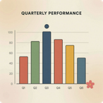


What's Next?
You've mastered the fundamentals of Data Wrangling. Here's a roadmap of what to explore next as you level up your Pandas skills.
Data Visualization
Merging & Grouping
Machine Learning Prep
Use matplotlib and seaborn to create charts and graphs from your clean data. Seeing your data is the next step after cleaning it.
Learn groupby(), merge(), and pivot_table() to combine datasets and summarize data by category.
Explore feature engineering with sklearn — encoding categorical variables, scaling features, and building your first model.
Practice Tip: Find a free dataset on Kaggle and apply today's full pipeline from scratch!
Notes:
29

